Slide 1

Ethics, Bias, and Fairness Part II
Rayid Ghani and Kit Rodolfa

Slide 2
Short Quiz

Slide 3
Reminders
This week:
No class / project check-ins on Wednesday/Thursday
Coming up next week:
Update assignment TBD?
Readings for Tuesday: causality and field validation

Slide 4
Plan for the week
What you should be discussing with your team this week
Fairness metrics and group attributes
What you should be building this week
Models: Finishing up any last additions to your model grid & selection
Bias Audit: Evaluating trade-offs between fairness and performance metrics in your model grid

Slide 5
Scope
Data
Exploration
Modeling
Get Data
Store Data
Link Data
Rows
Features
Labels
Model Selection
Train-Test Splits
Performance Metrics
Model Interpretation
Entities
temporal
Spatial
…
Models
Dealing with Bias and Fairness
Field Trial Design
Deployment
Monitoring
Goals, Actions, Data, Analysis, Ethics

Slide 6
Recap: Most of these questions are not new
Ethical issues have always existed in every decision-making process but we are dealing with them now at a different scale and with a more data-driven view

Slide 7
Data and AI Ethics Issues
Privacy
Data Ownership
Bias, Equity, & Fairness
Transparency
Trustworthiness and Accountability

Slide 8
Data and AI Ethics Issues
Privacy
Data Ownership
Bias, Equity, & Fairness
Transparency
Trustworthiness and Accountability

Slide 9
Many Bias Measures: How do we select what we care about?

Slide 10
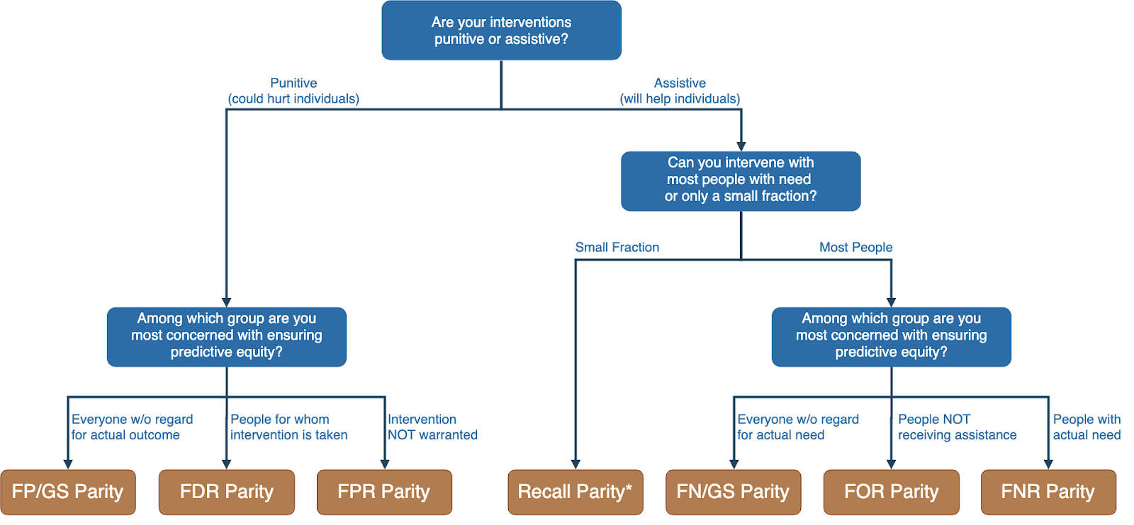
Translating policy goals to fairness metrics

Slide 11
Where does this leave us?
What can we do to understand bias and improve fairness of our systems?
Bias and equity audits
Try to fix the input data
Optimize for fairness in model training
Choose fair models during model selection
Post-hoc adjustments to de-bias model scores
Measure relative effectiveness of interventions across groups and develop better-tailored interventions

Slide 12
Where does this leave us?
What can we do to understand bias and improve fairness of our systems?
Bias and equity audits
Try to fix the input data
Optimize for fairness in model training
Choose fair models during model selection
Post-hoc adjustments to de-bias model scores
Measure relative effectiveness of interventions across groups and develop better-tailored interventions

Slide 13

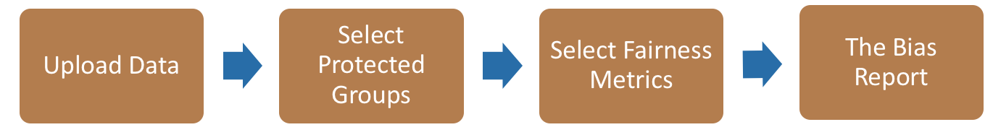
Bias Audit Flow
Race
Sex
Age
Equal False
Omission Rate
Risk Score and Outcomes

Slide 14
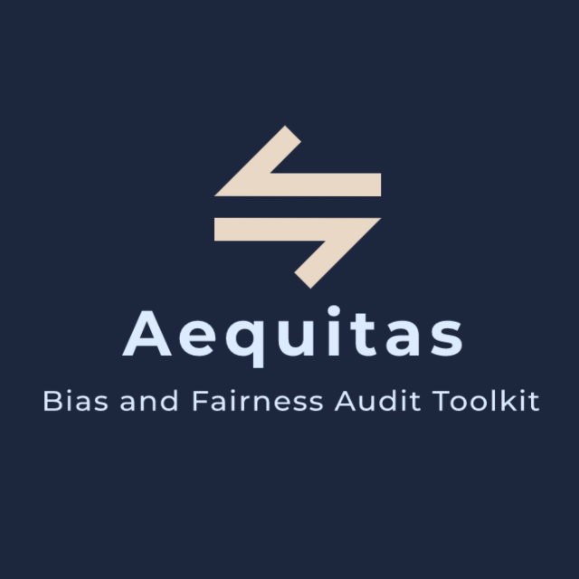
Bias Audit
http://www.datasciencepublicpolicy.org/aequitas/

Slide 15
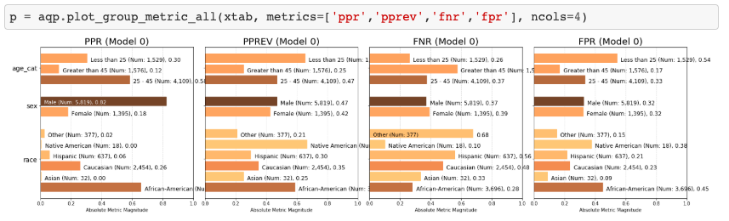
Auditing COMPAS Disparities

Slide 16
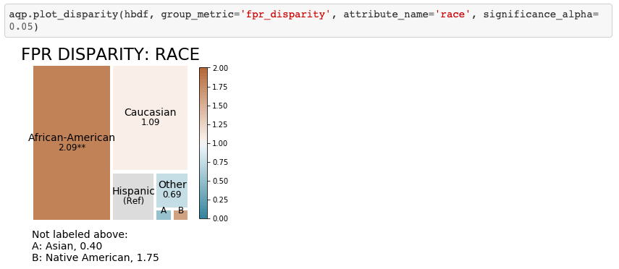
Auditing COMPAS Disparities

Slide 17
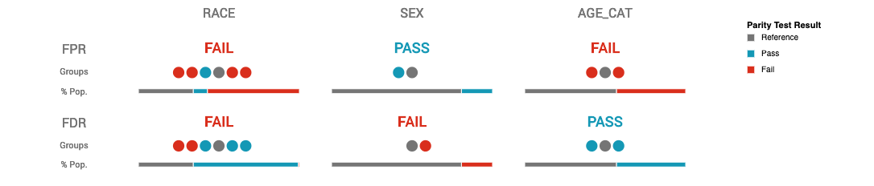
Auditing COMPAS Disparities

Slide 18
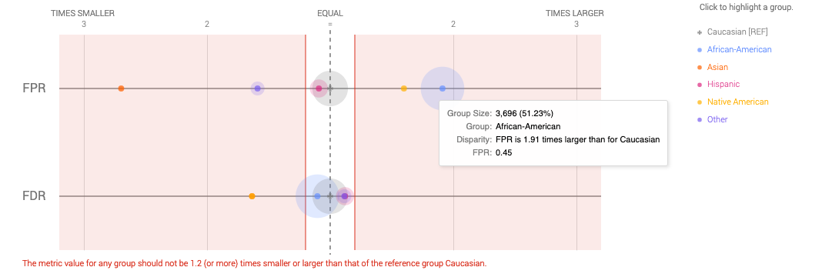
Auditing COMPAS Disparities

Slide 19
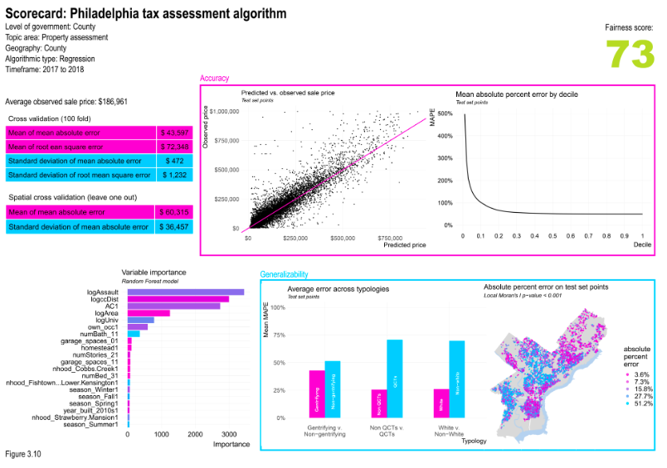
Fairness Scorecards
https://urbanspatial.github.io/AlgorithmicFairness_ACodebasedPrimerForPublicSectorDataScientists/

Slide 20
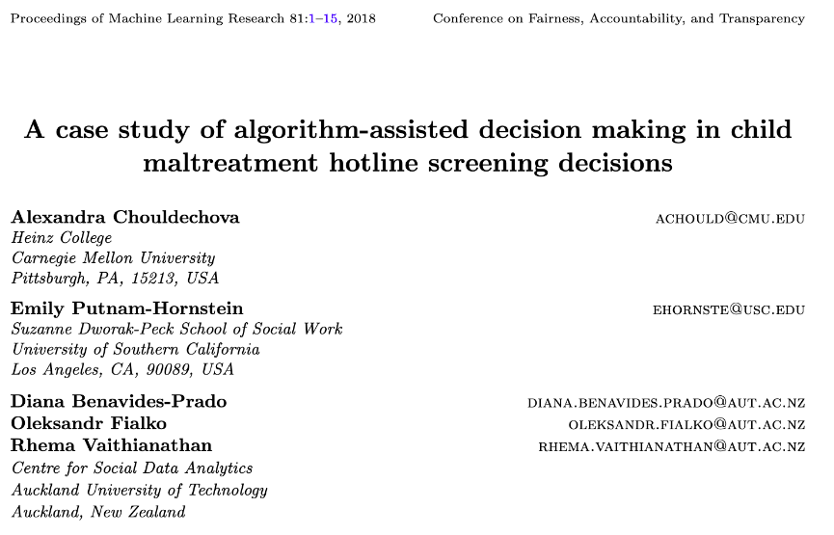
Child Welfare Case Study

Slide 21
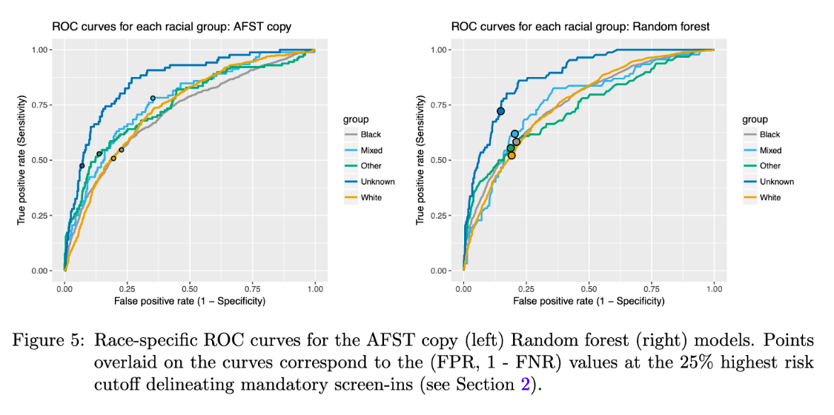
Child Welfare Case Study

Slide 22
Child Welfare Case Study
“We see that even though the ROC curves lie quite close to one another for most groups, the chosen threshold corresponds to different points on the ROC curves for different groups…. This FPR imbalance could lead to a perception that Mixed-race families are over- investigated relative to White families.
”

Slide 23
Where does this leave us?
What can we do to understand bias and improve fairness of our systems?
Bias and equity audits
Try to fix the input data
Optimize for fairness in model training
Choose fair models during model selection
Post-hoc adjustments to de-bias model scores
Measure relative effectiveness of interventions across groups and develop better-tailored interventions

Slide 24
0%
Performance Metric
100%

Slide 25
100%
Bias
0%
Performance Metric
100%

Slide 26
Case Study: Prioritizing Early Diabetes Screenings in a fair and equitable way

Slide 27
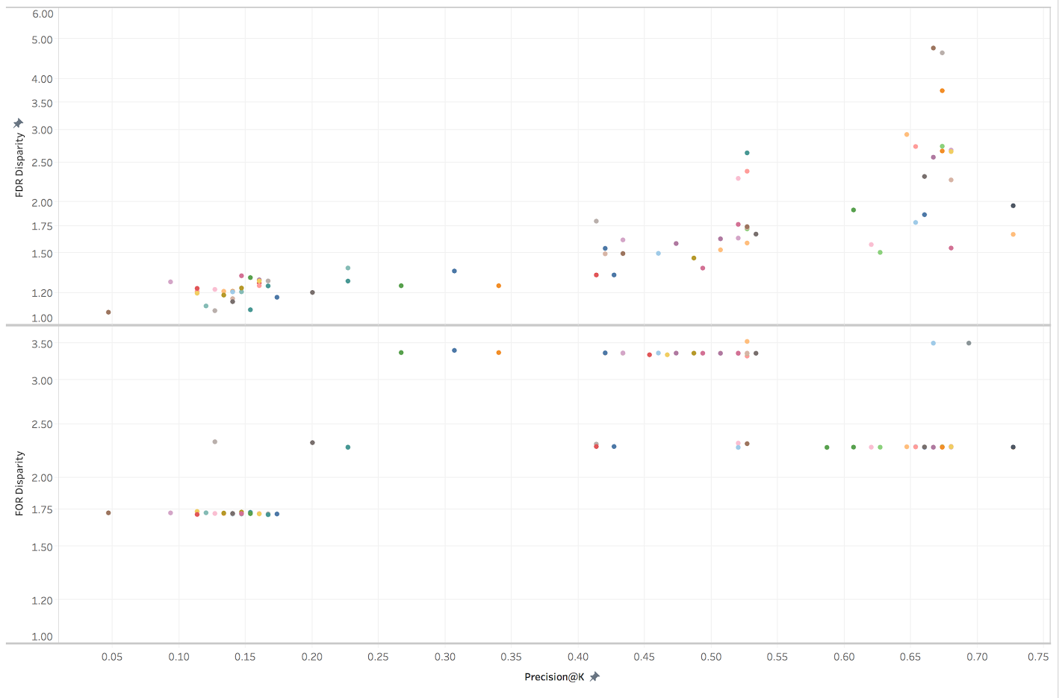
Bias vs P@10% on Gender
False Discovery Rate Disparity
False Omission Rate Disparity
Precision at the top 1%

Slide 28
Where does this leave us?
What can we do to understand bias and improve fairness of our systems?
Bias and equity audits
Try to fix the input data
Optimize for fairness in model training
Choose fair models during model selection
Post-hoc adjustments to de-bias model scores
Measure relative effectiveness of interventions across groups and develop better-tailored interventions

Slide 29
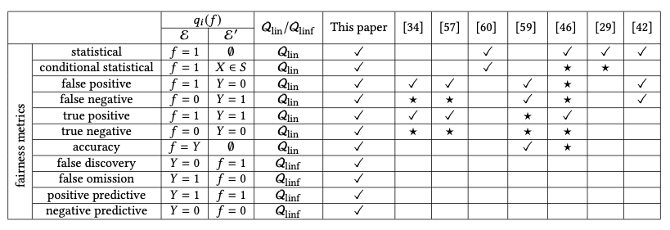
Optimize for Fairness in Model Training
General idea: modify optimization problem (for instance, by adding regularization terms to loss function) that account for fairness. Many implementations of different methods for various fairness metrics.

Slide 30
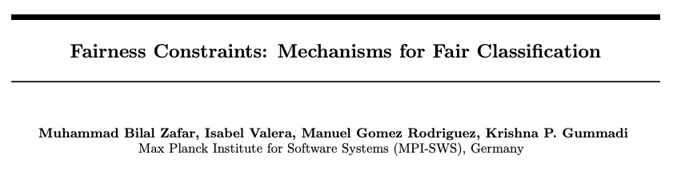
Optimize for Fairness in Model Training

Slide 31
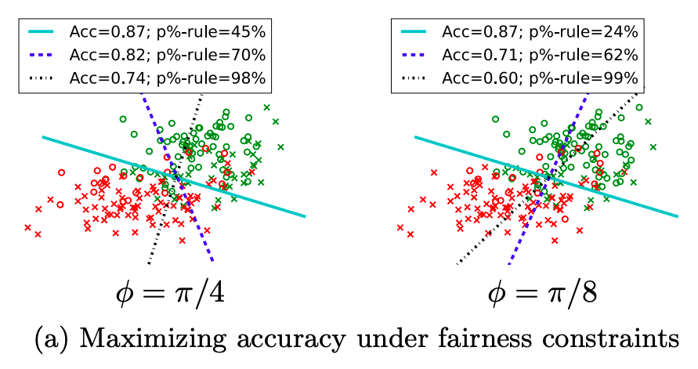
Optimize for Fairness in Model Training

Slide 32
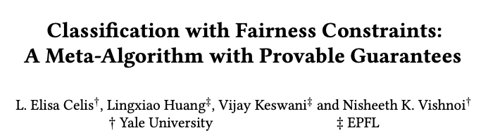
Optimize for Fairness in Model Training

Slide 33
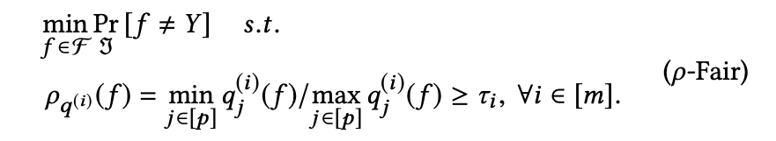
Optimize for Fairness in Model Training

Slide 34
Optimize for Fairness in Model Training
“group performance function”
capturing the equity metric
of interest

Slide 35
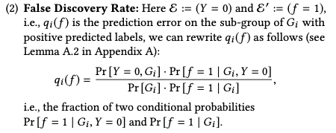
Optimize for Fairness in Model Training
for example:

Slide 36
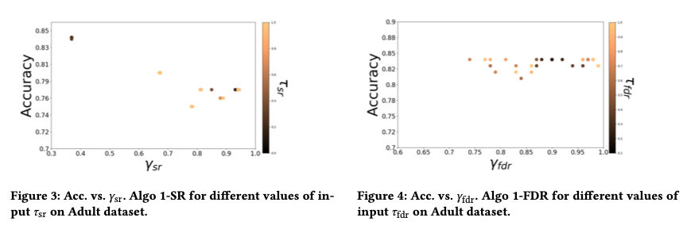
Optimize for Fairness in Model Training

Slide 37
Optimize for Fairness in Model Training: Advantages
Idea of an “all-in-one” solution is appealing
Provides some flexibility, especially when group membership not known exactly (e.g., gender estimated from name or race from census data)

Slide 38
Optimize for Fairness in Model Training: Limitations
Limited set of algorithms to do this directly, though also black-box options (often end up doing the same thing as post-hoc score adjustments)
Doesn’t preclude the need to auditing, assessment, and model selection – need to confirm the effectiveness of the constraint!
Generally don’t work well for “top k” problems off the shelf

Slide 39
Where does this leave us?
What can we do to understand bias and improve fairness of our systems?
Bias and equity audits
Try to fix the input data
Optimize for fairness in model training
Choose fair models during model selection
Post-hoc adjustments to de-bias model scores
Measure relative effectiveness of interventions across groups and develop better-tailored interventions

Slide 40

Post-hoc Adjustments

Slide 41
Post-hoc Adjustments
aka recall or TPR

Slide 42
Post-hoc Adjustments
“That is, to require that people who pay back their loan have an equal opportunity of getting a loan in the first place.
”

Slide 43
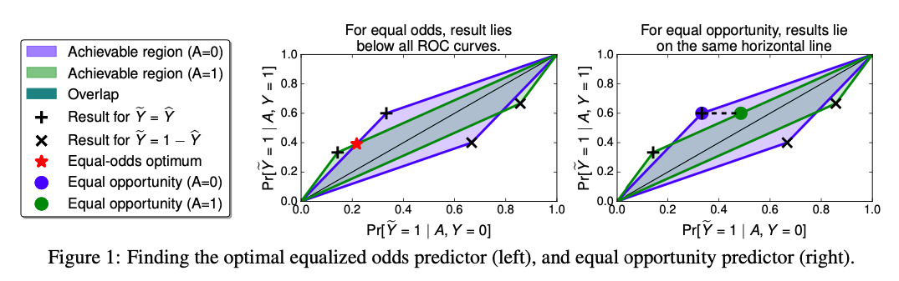
Post-hoc Adjustments

Slide 44
Case Study: Post-hoc Adjustments and Policy Goals
Cycle of Incarceration
UNMET
NEEDS
MISDEMEANOR
ARREST
JAIL
worsening or failing to improve

Slide 45
Case Study: Post-hoc Adjustments and Policy Goals
Breaking the Cycle
UNMET
NEEDS
X
MISDEMEANOR
ARREST
JAIL
TAILORED
INTERVENTION

Slide 46
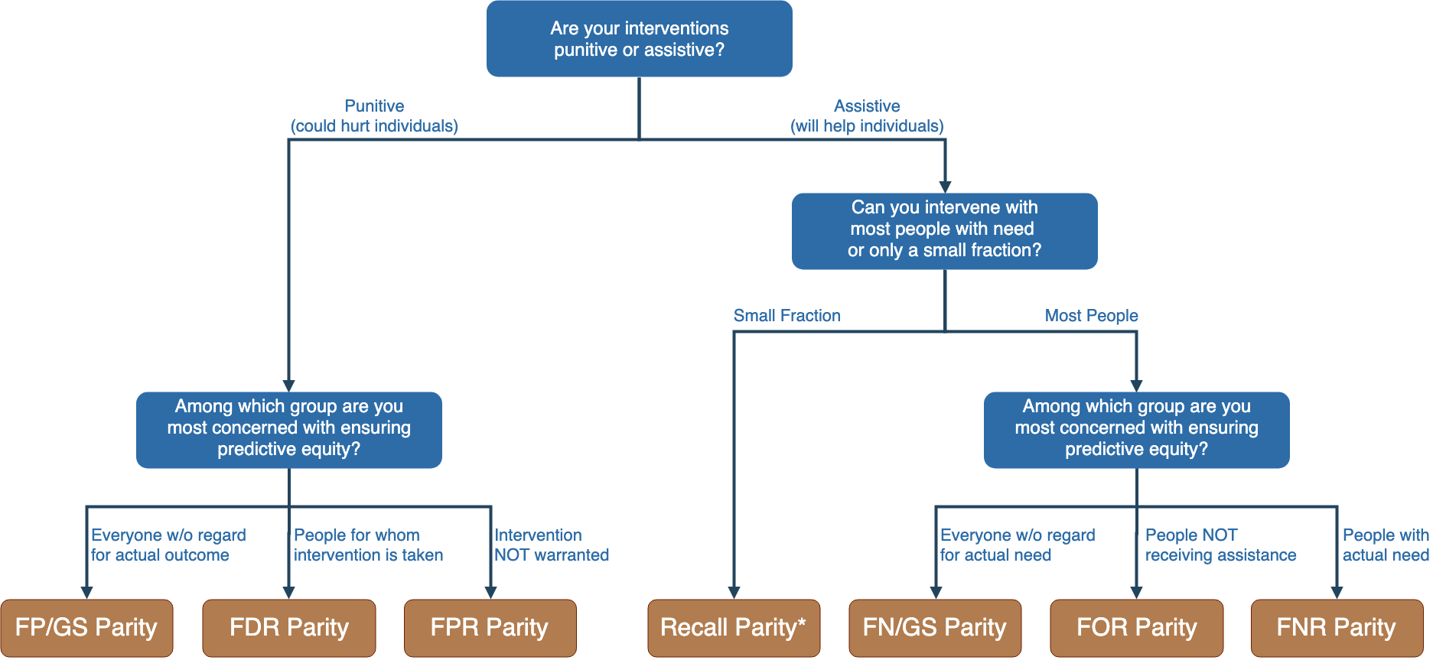
Notes:
Context-dependence of fairness definition
Idea of fairness tree is starting point for conversations with stakeholders, help guide discussion
In assistive program with resource constraints, focus on recall parity (equivalent to equality of opportunity discussed by Hardt and others --- also “sensitivity” and TPR and 1-FNR)

Slide 47
Notes:
Context-dependence of fairness definition
Idea of fairness tree is starting point for conversations with stakeholders, help guide discussion
In assistive program with resource constraints, focus on recall parity (equivalent to equality of opportunity discussed by Hardt and others --- also “sensitivity” and TPR and 1-FNR)

Slide 48
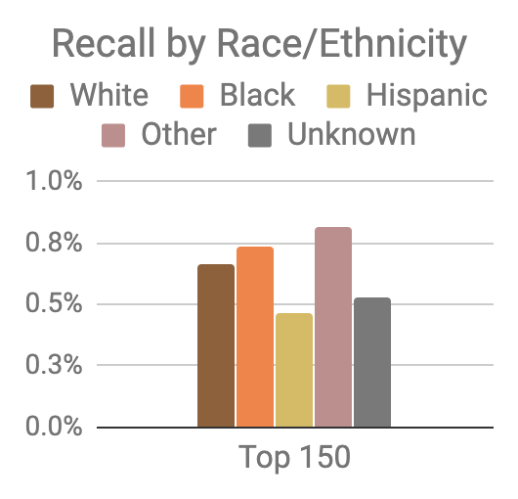
Model was optimized for efficiency, not equity
Top 150 highest risk reasonably balanced between black and white individuals
However, hispanic and unknown race/ethnicity groups very underrepresented

Slide 49
Mitigating Disparities
Single Threshold
White
Black
Hispanic
Recall
Lower Scores / Higher Recall
Group Thresholds
Recall

Slide 50
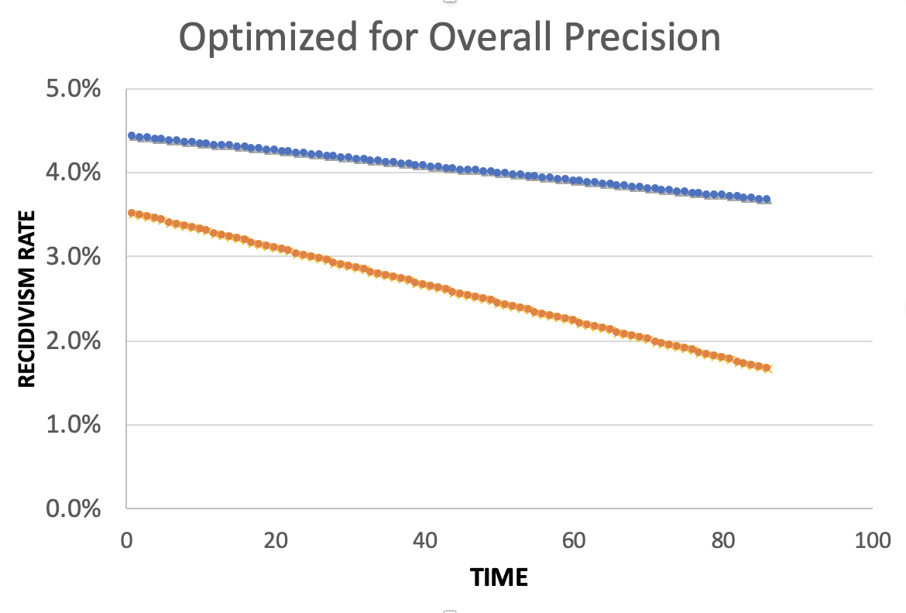
Equality of Predictions vs Underlying Disparities
Widening Gap:
Disparities Getting
Larger Over Time

Slide 51
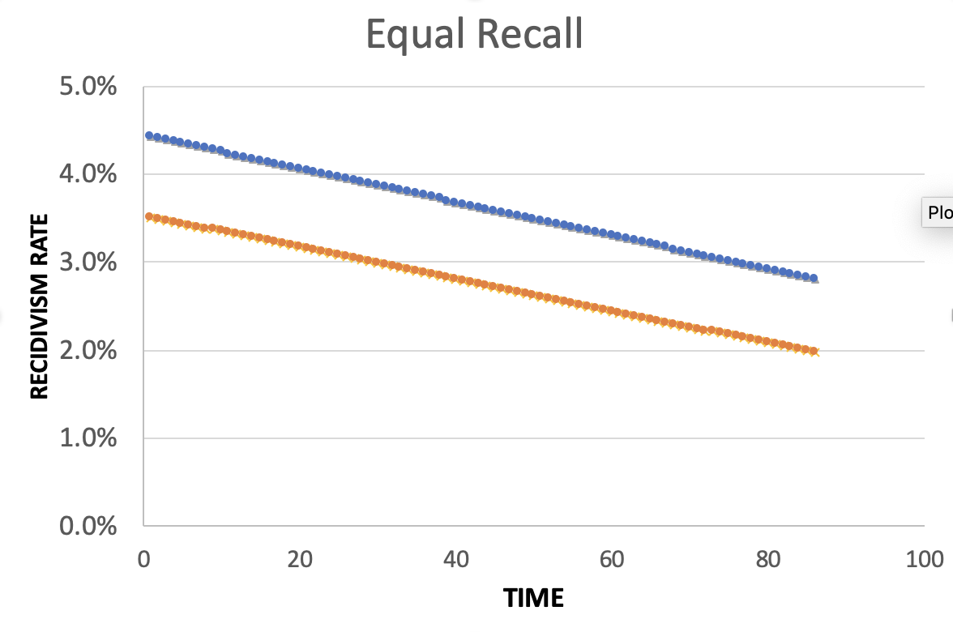
Equality of Predictions vs Underlying Disparities
Parallel Lines:
Disparities Remain
Constant Over Time

Slide 52
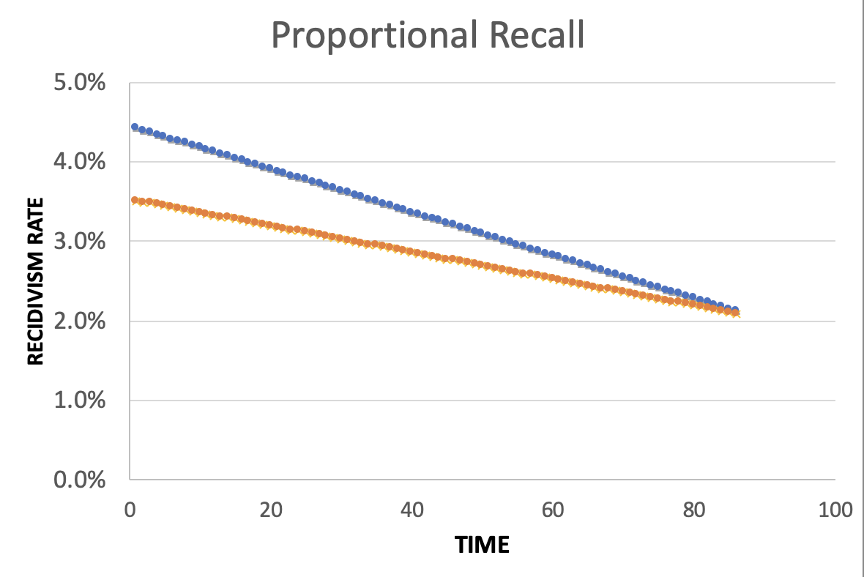
Equality of Predictions vs Underlying Disparities
Converging Lines:
Disparities Decrease
Over Time

Slide 54
Menu of Options
Current Scale
Expanded Scale
No
Constraint
Equalize
Recall
Reduce
Disparities

Slide 55
Menu of Options
Current Scale
Expanded Scale
No
Constraint
INITIAL
MODEL
Equalize
Recall
Reduce
Disparities

Slide 56
Menu of Options
Current Scale
Expanded Scale
No
Constraint
Equalize
Recall
EXPLICIT
EQUITY / EFFICIENCY
TRADE-OFF
“COST OF
EQUITY”
Reduce
Disparities

Slide 57
Menu of Options
Current Scale
Expanded Scale
No
Constraint
Equalize
Recall
IMPROVE OUTCOMES AT SAME
RATE ACROSS GROUPS
Reduce
Disparities
IMPROVE OUTCOMES FASTER FOR GROUPS
WITH HIGHER INCARCERATION RATES
Notes:
For the “Reduce Disparities” options, we targeted recall levels in proportion to underlying prevalence in the population. Could make other choices, but this has the nice property of readjusting as these prevalences change while also still distributing resources across all groups, but one could reasonably take many possible approaches.

Slide 58
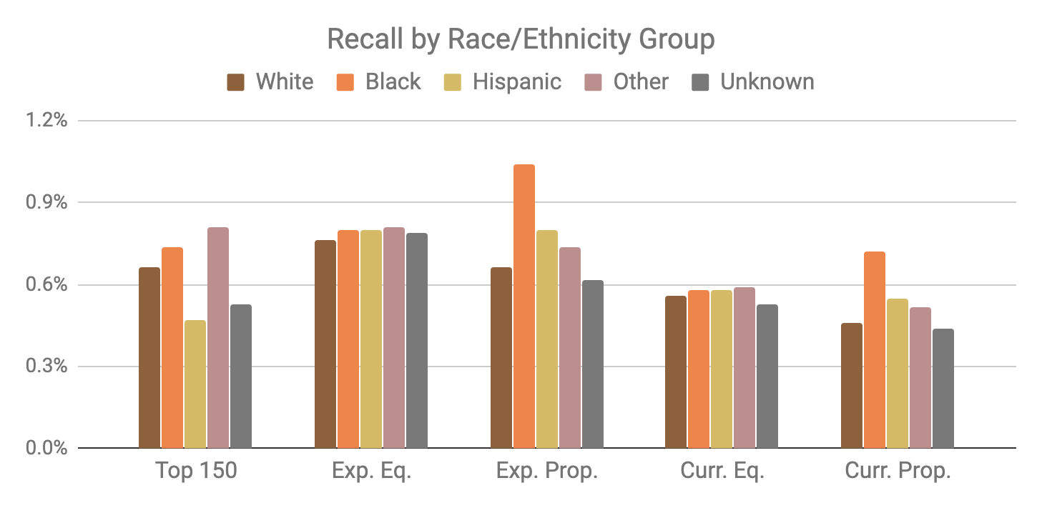
Base Model
Expanded Scale
Current Scale

Slide 59
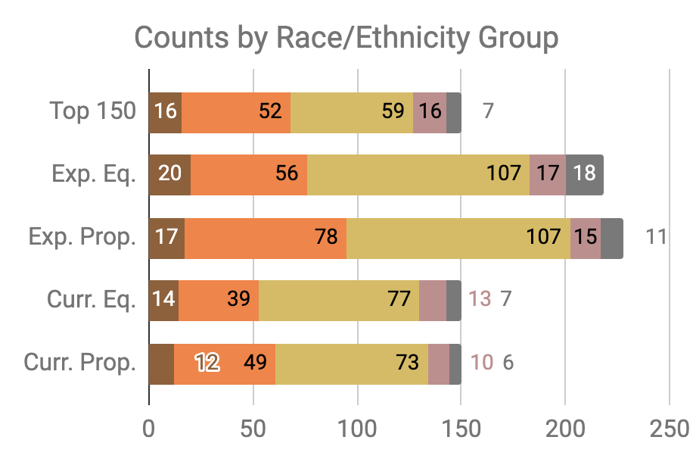

Slide 60
Little Equity/Efficiency Trade-Off at Current Scale
Top 150
72.7%
Precision
150
Total Count
Equal
Recall
70.7%
Precision
150
Total Count
Proportional
Recall
70.7%
Precision
150
Total Count

Slide 61
Where does this leave us?
What can we do to understand bias and improve fairness of our systems?
Bias and equity audits
Try to fix the input data
Optimize for fairness in model training
Choose fair models during model selection
Post-hoc adjustments to de-bias model scores
Measure relative effectiveness of interventions across groups and develop better-tailored interventions

Slide 62
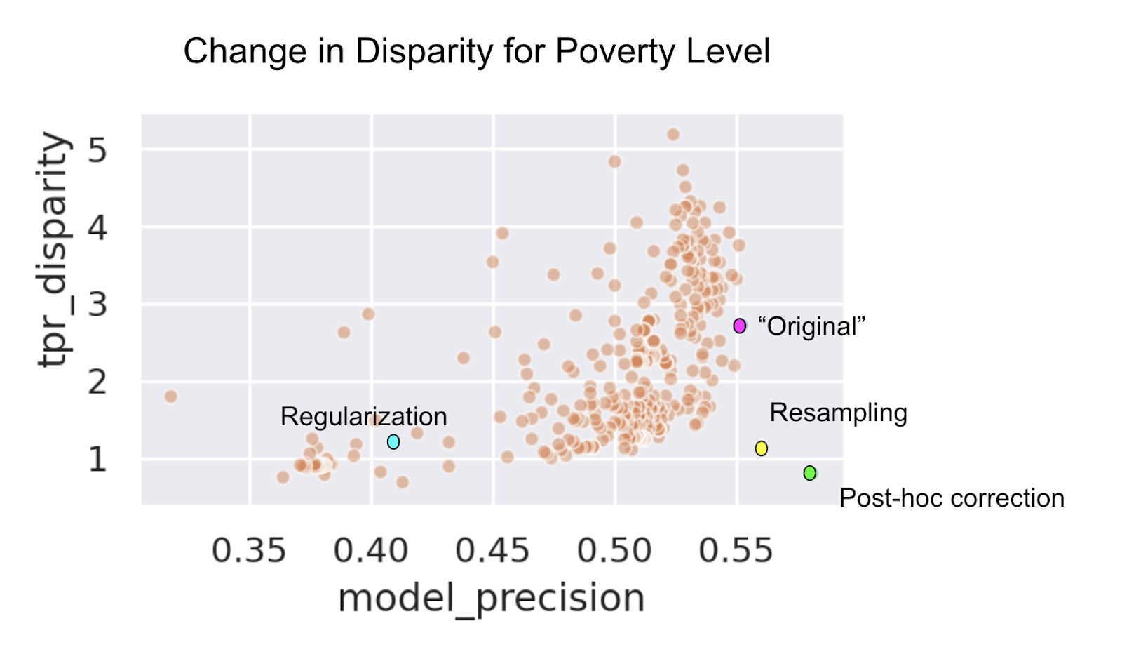

Slide 63
Data and AI Ethics Issues
Privacy
Data Ownership
Bias, Equity, & Fairness
Transparency
Trustworthiness and Accountability

Slide 64
Data and AI Ethics Issues
Privacy
Data Ownership
Bias, Equity, & Fairness
Transparency
Trustworthiness and Accountability

Slide 65
Privacy, Inference, and Levels of control
While we may want controls at all levels, we want stronger
controls as we go down these levels
(Not collecting my data)
Collection Control
Action Control (Not taking certain actions on me)
Access Control
Inference Control
(Not giving access to my data)
(Not inferring something about me)

Slide 66
Data and AI Ethics Issues
Privacy
Data Ownership
Bias, Equity, & Fairness
Transparency
Trustworthiness and Accountability

Slide 67
Transparency is not about displaying the model that was built

Slide 68
What does it take for an analysis to be transparent?
Code for the analysis
Model that was built
Data that was used
…

Slide 69
We have to be able to explain and disclose
Processes—what the analysis pipeline and algorithm does
How it does it
Who controls the algorithm
What data does it use
What is it being asked to optimize for
How well did it do what it was asked to do
What was its impact on different types of people

Slide 70
Data and AI Ethics Issues
Privacy
Data Ownership
Bias, Equity, & Fairness
Transparency
Trustworthiness and Accountability

Slide 71
Trustworthiness and Accountability
Do policymakers understand what the analysis is doing?
Do action-takers understand and trust why they’re getting the recommendations they’re getting?
Do the people being acted on understand why?
What recourse do people being acted on have to appeal these decisions or identify and correct errors in the data or system?

Slide 72
Trustworthiness and Accountability
Who is accountable for the actions?
Who is deciding on the values encoded in the system?
Who is deciding when to (and not to) undertake a project?
How is the tradeoff between false positive and false negatives being set?

Slide 73
The Role for Interpretability
Debugging the Model
Creating and increasing trust and adoption
Improving the decisions being made
Selecting appropriate interventions
Legal Recourse

Slide 74


What is a good explanation and how do we evaluate one?
Ideally: We want human understandability and fidelity to the actual model
Task Specific: We want an explanation to improve the performance of the Human-ML system
73%
ML Model
Human Decision-maker
?%
ML Model
Explanation Module
Human Decision-maker

Slide 75
Examples
Predictive Policing: Why could it be bad?

Slide 76
Examples
Predictive Policing: Why could it be bad?
Data
Interventions
Counterfactuals
Are there good use cases for crime prediction?

Slide 77
Examples
Predictive Policing: Why could it be bad?
Data
Interventions
Counterfactuals
Are there good use cases for crime prediction?
Preventative Assistance Programs in Criminal Justice?

Slide 78
Data and AI Ethics Issues
Privacy
Data Ownership
Bias, Equity, & Fairness
Transparency
Trustworthiness and Accountability

Slide 79
What do we need
Training (for analysts, managers, and policymakers)
Bias Audit Checklists and Processes
Tools (to help AI developers build equitable systems) that are embedded in to the workflow
“Insurance” Budget to test, monitor, and evaluate systems for equity
Regulations and Review Boards

Slide 80
Steps we’re taking
Training (lots of it)
Tools – for different stages of projects embedded in the ML and project workflow
Case Studies
Providing choices with clear policy implications
Focus on outcomes and actions – fair outcomes
Experiments
Research
Discovering biased populations subgroups when we don’t have predefined “protected” groups
Detecting causes/sources of Bias
Comparing different approaches to “correct” for the bias
Using bias as a primary metric to do model selection over time

Slide 81
Summary
Create an environment where informed ethical discussions can take place
Talk through ethical issues at each stage of the project (instead of waiting till the end of stopping after the initial setup)
Consider the entire chain of data - collection to analysis to action
Consider how it affects people throughout the chain – especially the people being affected (and include them in these discussions)
Embed ethics into both technical processes as well as people processes

Slide 82
Readings
Policy Paradox
Ethics and Data Science
Ethics and Policy in Data Science (Class at Cornell)
First, Do No Harm
FATML (workshops that have been happening for the past 4 years)

Slide 83
Useful Resources
Data Science Project Scoping Guide
Data Maturity Framework
Hitchhikers Guide to DSSG: Data Science Tutorials
Data Science Tools
Triage: data science pipeline (under development)
Aequitas: Bias Audit Tool (under development)
Explainer: Explaining individual predictions from ML models (upcoming)
Code for other projects: www.github.com/dssg

Slide 84
Reminders
Assignment for Tuesday:
Updates based on feedback
Readings for Thursday: Bias & Fairness Part II

